Slide 1

Game Sales by Month
By Arden and Michael

Slide 2

Part 1: Gathering Sources

Slide 3
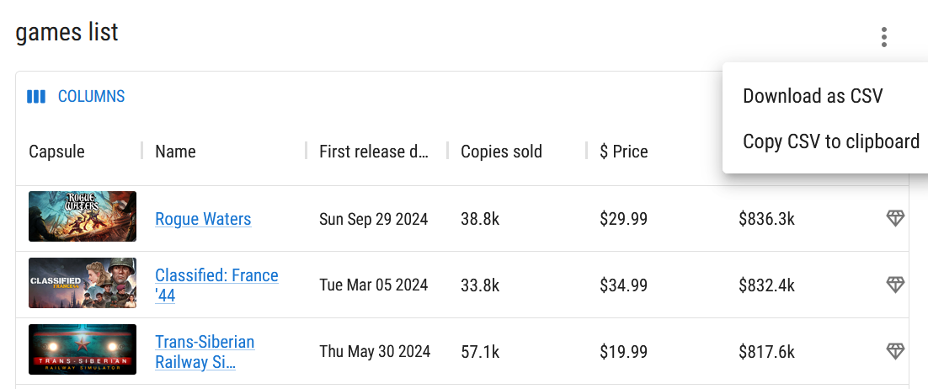
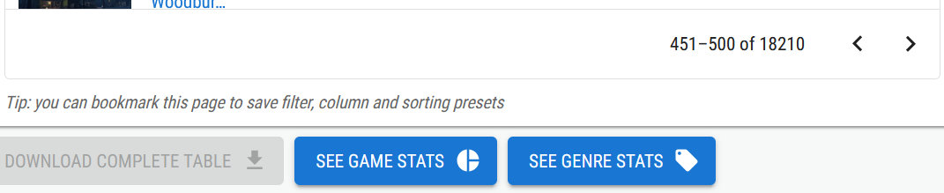
Gamalytic
One of the simpler methods of data collection, we were able to download most of the information.
Very useful filtering methods, many options to choose from.
Notes:
Forced to download 50 games at a time

Slide 4
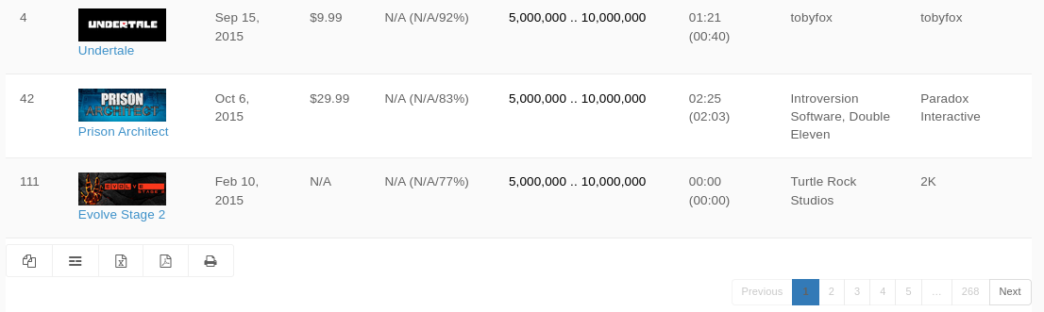

SteamSpy
We intended to use the SteamSpy Api to gather data, but it did not provide release dates for provided games.
Download CSV
The website’s feature to download a CSV of the currently filtered year was used instead.

Slide 5
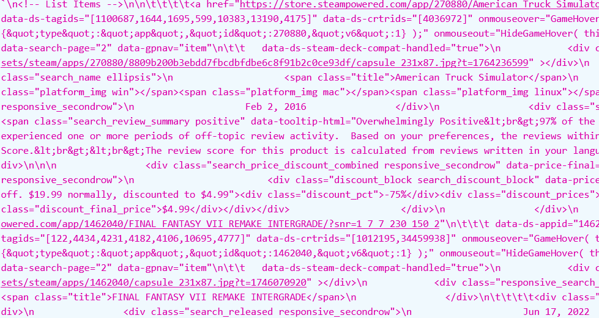
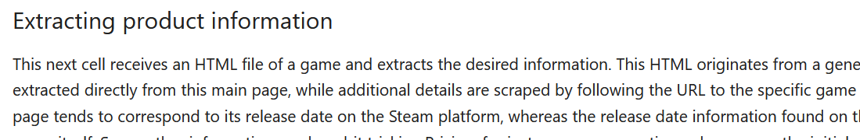
Webscraping
We are not the first people to try scraping game information from Steam.
Still, I needed to figure out how to get the specific information needed.

Slide 6

Part 2:
Combining the Data

Slide 7

Important Steps
This was all done in python for simplicity
Main steps of combining data:
Dumping CSVs
Filtering unusable data
Combining into a DataFrame

Slide 8
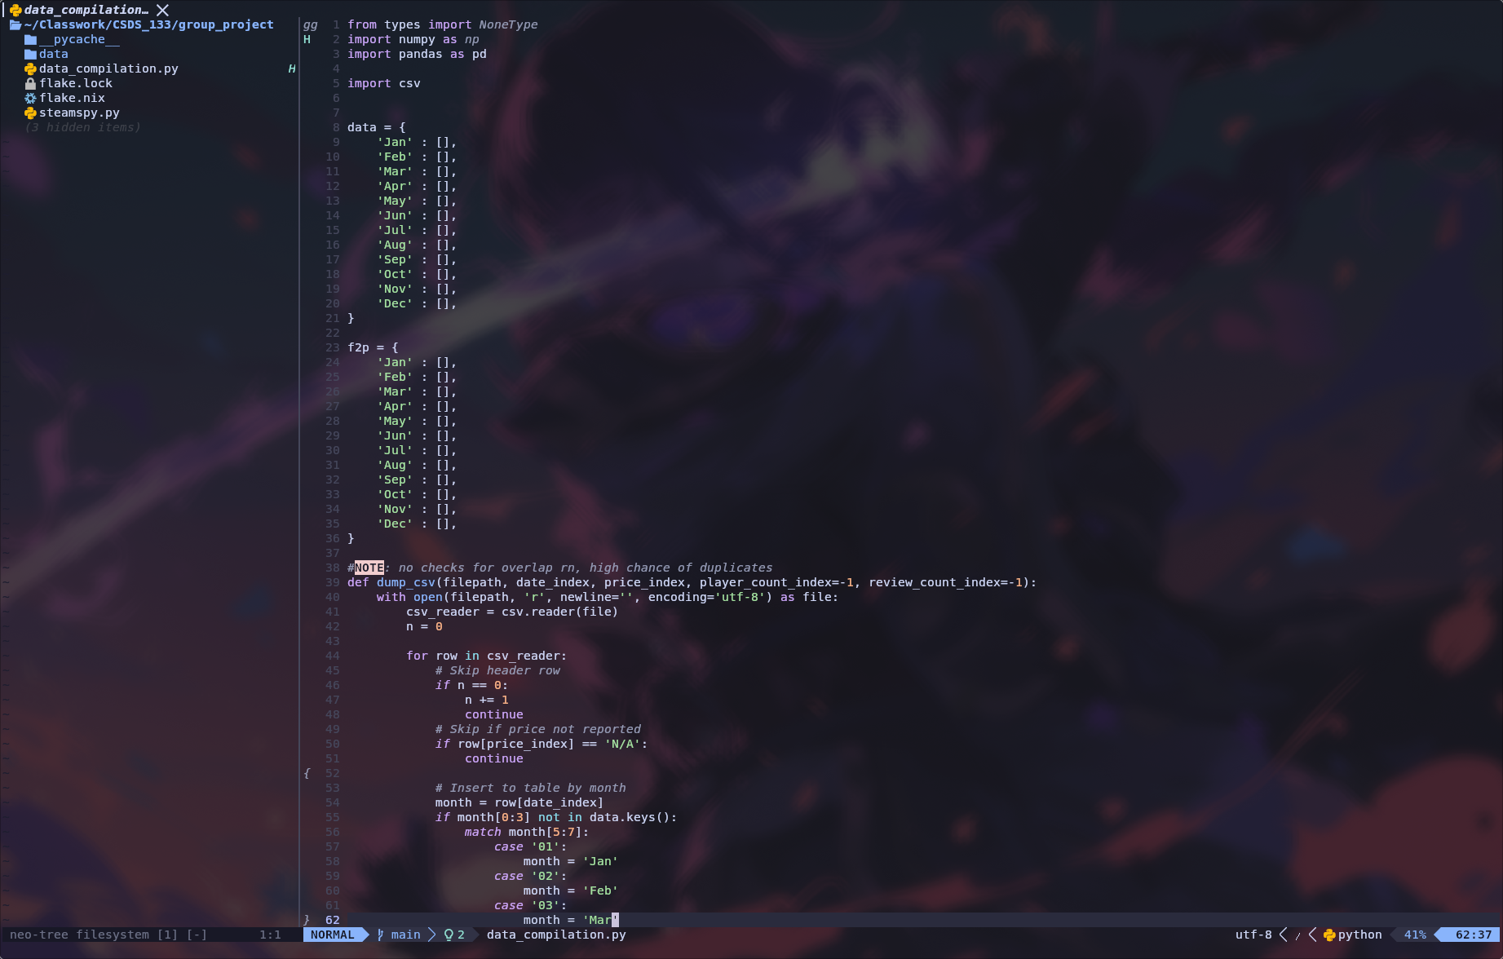
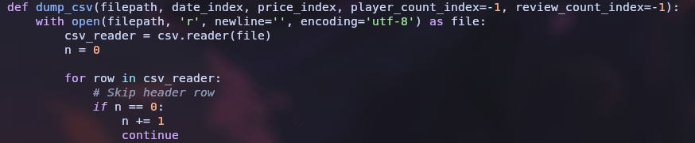
Dumping CSVs
Using python’s built in csv library, lines are read directly from the csv files as a list

Slide 9
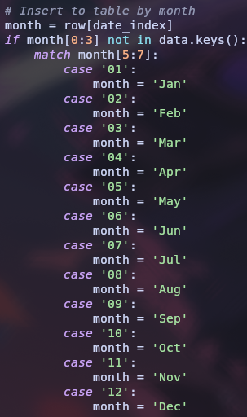
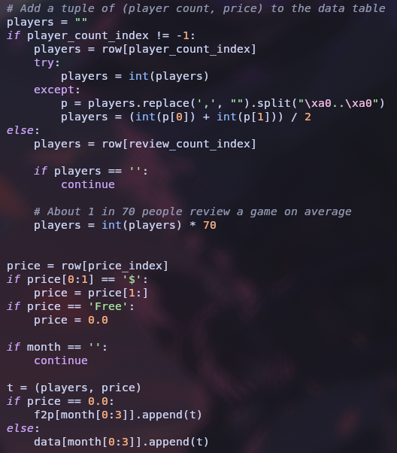
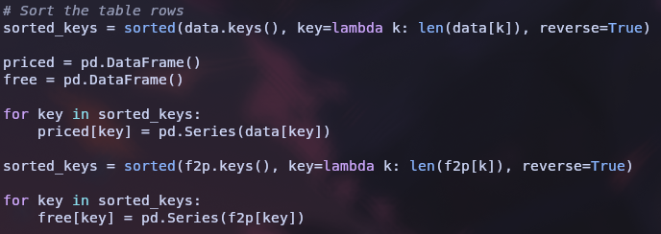
Filtering and Combining
Data dumped from the CSVs is sorted into a table (f2p or priced), with month as the key.
Data points without needed information are skipped.
Data in each table is added to a dataframe, sorted by # of releases per month

Slide 10
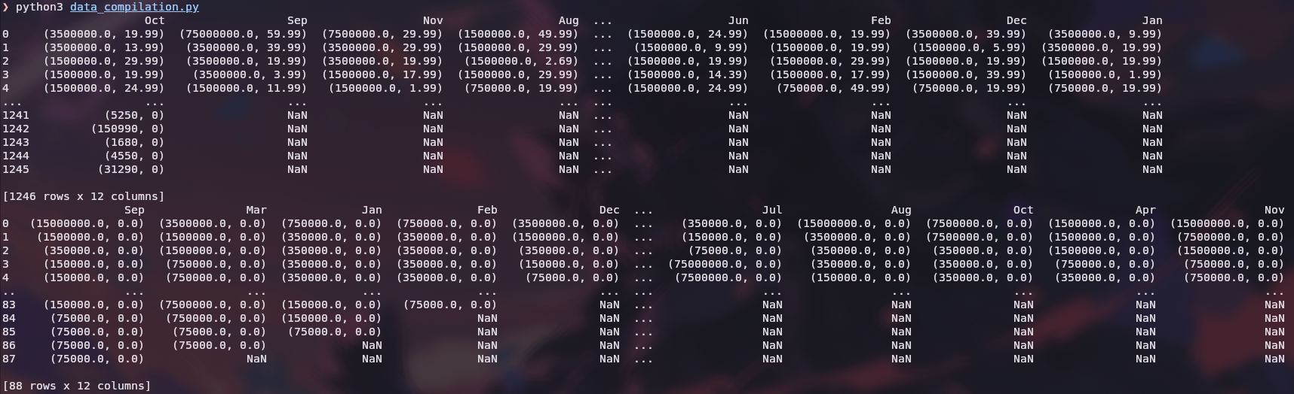
Final Dataframe Examples

Slide 11
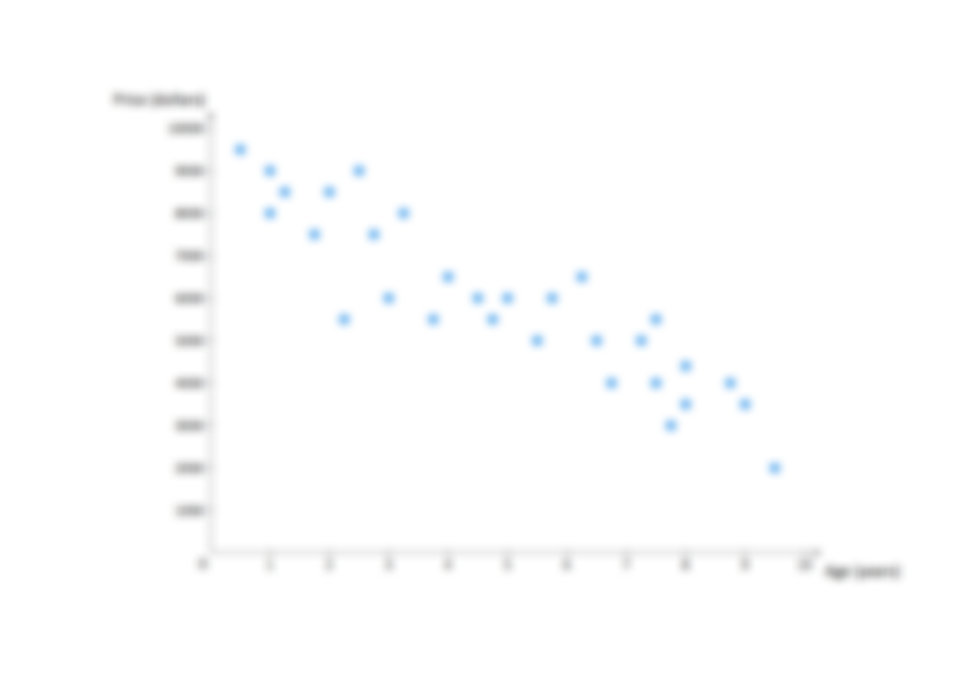
Part 3: Our Findings
Understanding the Data

Slide 12
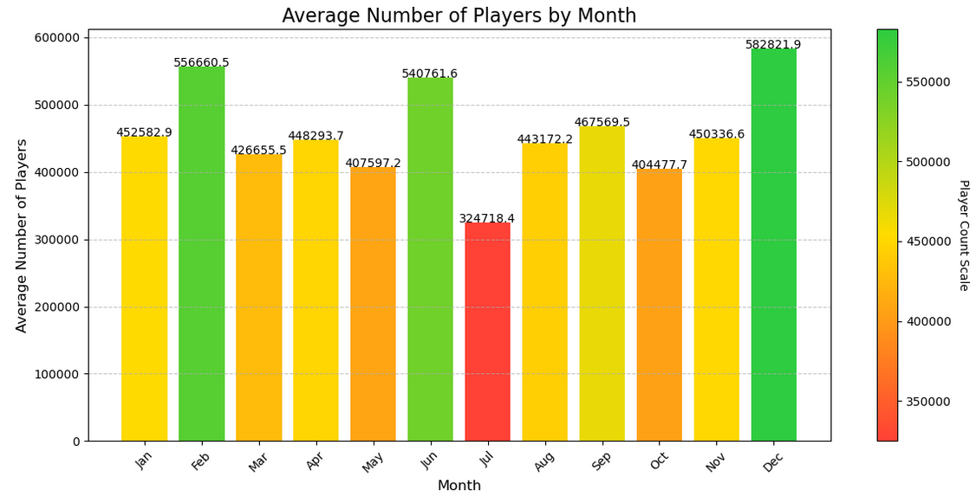
Average number of players by month
There tend to be peaks at February, June, and December, but a surprising lack of players in July.

Slide 13
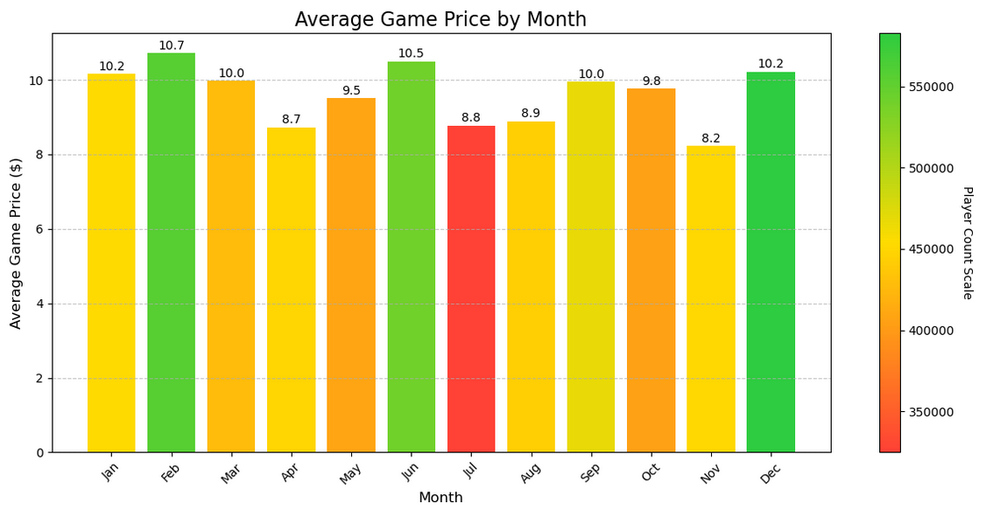
Game Prices
Prices seem to be slightly higher on average during peak months, though November has a significant drop in prices without a drop in players.

Slide 14
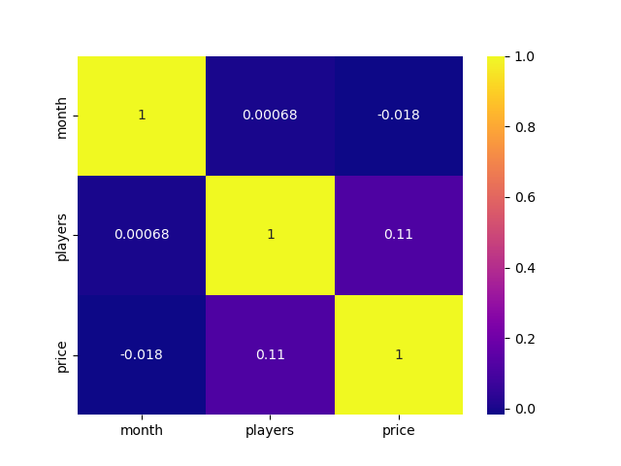
Heatmap
Overall, not much correlation can be drawn between the month, player count, and price.
The correlation between price and player count is statistically significant (>0.05), but still fairly weak.

